Slide 1
SQL Plus And iSQL*PLUS

Slide 2
SQL * Plus is a powerful interface tool from Oracle to interact with the database.
Using SQL * Plus, one can execute
  all SQL statements and PL/SQL programs,
  Format results from queries.
  Administer the database
iSQL*Plus is the web interface for SQL*Plus.

Slide 3
iSQL*Plus Architecture
iSQL*Plus uses a three-tier architectural model comprising of
Client Tier
(iSQL*Plus user interface, typically a web browser).
Middle Tier
  (iSQL*Plus Server, Oracle Net, Oracle HTTP Server).
Database Tier
  (Oracle 11g).

Slide 4
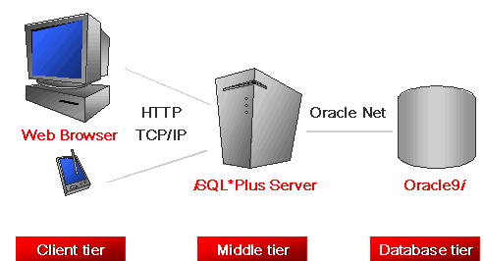

Slide 5
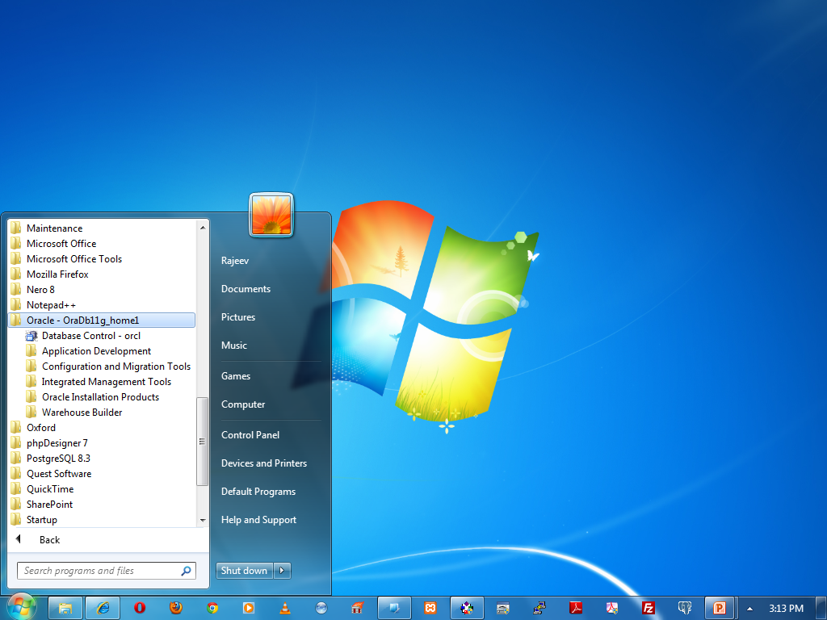
Open iSQL * Plus.
Click Start ->
All Programs ->
Oracle - OraDb11g_home1 ->
Database Control - orcl

Slide 6
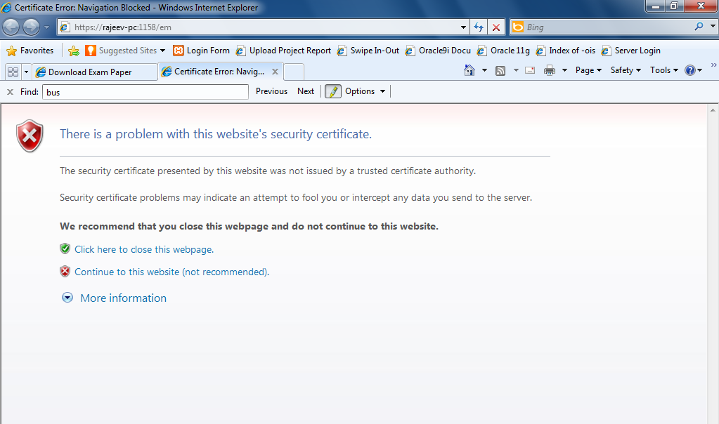
https://localhost:1158/em
Click here to continue

Slide 7
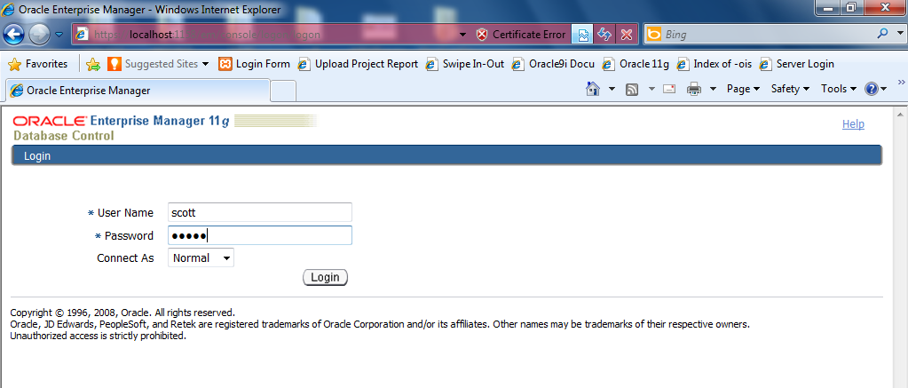
"Scott" against User Name box, and “tiger" against Password box. Click "Ok" button to login.

Slide 8
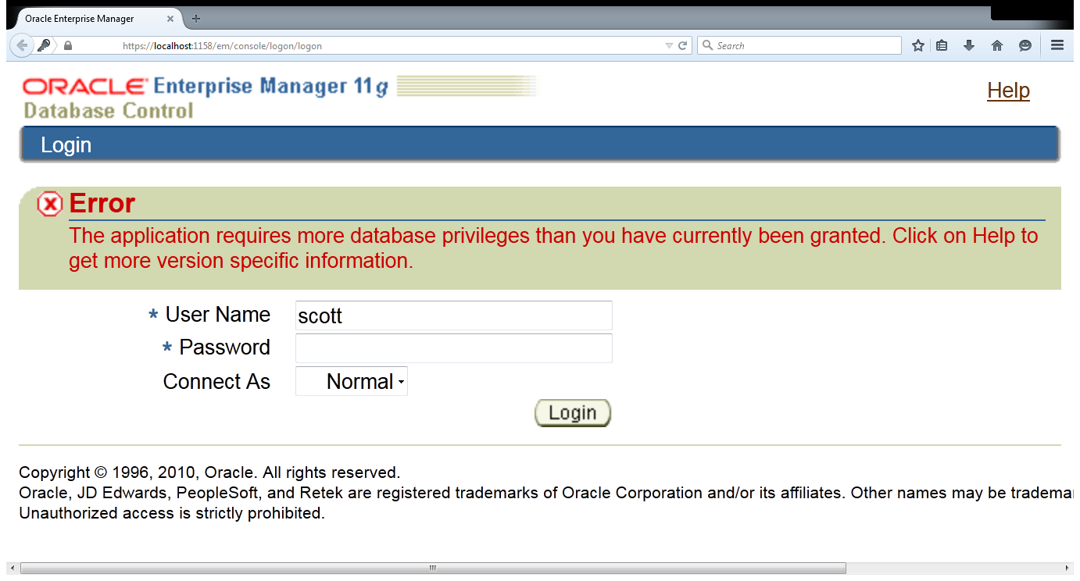
The application requires more database privileges than you have currently been granted. Click on Help to get more version specific information.

Slide 9
Connect to sys as sysdba
Type below sql statement :
GRANT SELECT_CATALOG_ROLE TO SCOTT;

Slide 10
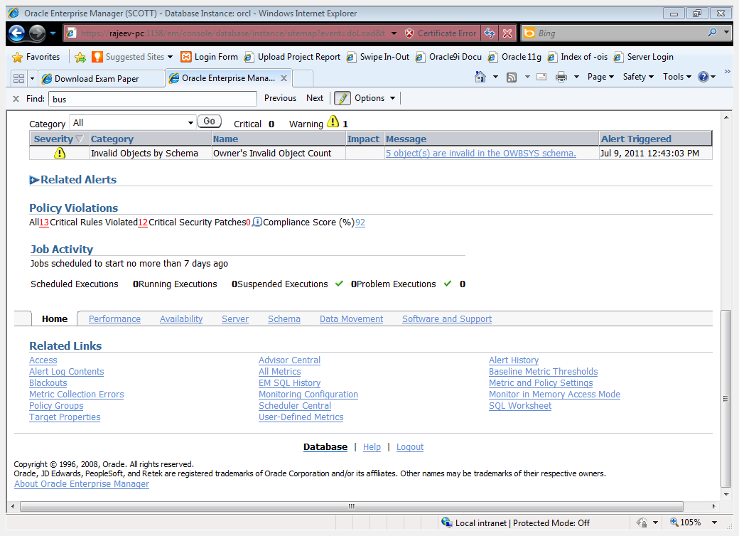
Click here to open SQL worksheet

Slide 11
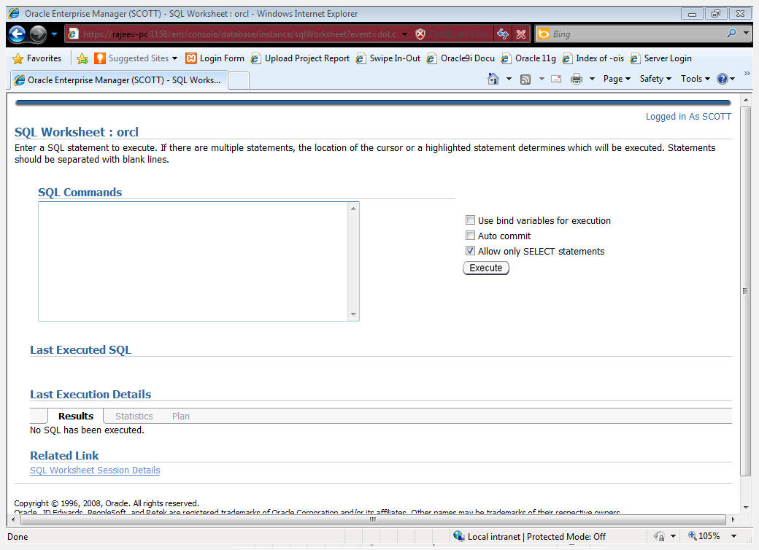
The iSQL*Plus Work Sheet
After clicking SQL worksheet, the iSQL*Plus Work sheet is displayed.

Slide 12


SQL Statements Versus SQL*Plus Commands
SQL
  A language
  ANSI-standard
  Keywords cannot be
  abbreviated
  Statements manipulate data
  and table definitions in the
  database
SQL*Plus
  An environment
  Oracle-proprietary
  Keywords can be abbreviated
  Commands do not allow manipulation of values in the database
SQL
statements
SQL
buffer
SQL*Plus
commands
SQL*Plus
buffer
Notes:
Oracle Database 11g: SQL Fundamentals I D - <number>
SQL and SQL*Plus (continued)
The following table compares SQL and SQL*Plus:

Slide 13
Displaying Table Structure
Use the SQL*Plus DESCRIBE command to display the structure of a table:
SET DESC[RIBE] [LINENUM {ON | OFF } ]
DESC[RIBE] tablename
Notes:
Oracle Database 11g: SQL Fundamentals I D - <number>
Displaying Table Structure
In SQL*Plus, you can display the structure of a table using the DESCRIBE command. The result of the command is a display of column names and data types as well as an indication if a column must contain data.
In the syntax:
tablename The name of any existing table, view, or synonym that is accessible to
the user
To describe the DEPARTMENTS table, use this command:
SQL> DESCRIBE DEPARTMENTS
Name Null? Type
----------------------- -------- ---------------
DEPARTMENT_ID NOT NULL NUMBER(4)
DEPARTMENT_NAME NOT NULL VARCHAR2(30)
MANAGER_ID NUMBER(6)
LOCATION_ID NUMBER(4)

Slide 14
Displaying Table Structure
DESCRIBE departments
Name Null? Type
----------------------- -------- ------------
DEPARTMENT_ID NOT NULL NUMBER(4)
DEPARTMENT_NAME NOT NULL VARCHAR2(30)
MANAGER_ID NUMBER(6)
LOCATION_ID NUMBER(4)
Notes:
Oracle Database 11g: SQL Fundamentals I D - <number>
Displaying Table Structure (continued)
The example in the slide displays the information about the structure of the DEPARTMENTS table. In the result:
Null?: Specifies whether a column must contain data (NOT NULL indicates that a column must contain data.)
Type: Displays the data type for a column

Slide 15
SQL*Plus Editing Commands
  A[PPEND] text
  C[HANGE] / old / new
  C[HANGE] / text /
  CL[EAR] BUFF[ER]
  DEL
  DEL n
  DEL m n
Notes:
Oracle Database 11g: SQL Fundamentals I D - <number>
SQL*Plus Editing Commands
SQL*Plus commands are entered one line at a time and are not stored in the SQL buffer.
Guidelines
If you press [Enter] before completing a command, SQL*Plus prompts you with a line number.
You terminate the SQL buffer either by entering one of the terminator characters (semicolon or slash) or by pressing [Enter] twice. The SQL prompt then appears.

Slide 16
SQL*Plus Editing Commands
  I[NPUT]
  I[NPUT] text
  L[IST]
  L[IST] n
  L[IST] m n
  R[UN]
  n
  n text
  0 text
Notes:
Oracle Database 11g: SQL Fundamentals I D - <number>
SQL*Plus Editing Commands (continued)
Note: You can enter only one SQL*Plus command for each SQL prompt. SQL*Plus commands are not stored in the buffer. To continue a SQL*Plus command on the next line, end the first line with a hyphen (-).

Slide 17
Using LIST, n, and APPEND
LIST
1 SELECT last_name
2* FROM employees
1
1* SELECT last_name
A , job_id
1* SELECT last_name, job_id
LIST
1 SELECT last_name, job_id
2* FROM employees
Notes:
Oracle Database 11g: SQL Fundamentals I D - <number>
Using LIST, n, and APPEND
Use the L[IST] command to display the contents of the SQL buffer. The asterisk (*) beside line 2 in the buffer indicates that line 2 is the current line. Any edits that you made apply to the current line.
Change the number of the current line by entering the number (n) of the line that you want to edit. The new current line is displayed.
Use the A[PPEND] command to add text to the current line. The newly edited line is displayed. Verify the new contents of the buffer by using the LIST command.
Note: Many SQL*Plus commands, including LIST and APPEND, can be abbreviated to just their first letter. LIST can be abbreviated to L; APPEND can be abbreviated to A.

Slide 18
Using the CHANGE Command
LIST
1* SELECT * from employees
c/employees/departments
1* SELECT * from departments
LIST
1* SELECT * from departments
Notes:
Oracle Database 11g: SQL Fundamentals I D - <number>
Using the CHANGE Command
Use L[IST] to display the contents of the buffer.
Use the C[HANGE] command to alter the contents of the current line in the SQL buffer. In this case, replace the employees table with the departments table. The new current line is displayed.
Use the L[IST] command to verify the new contents of the buffer.

Slide 19
SQL*Plus File Commands
  SAVE filename
  GET filename
  START filename
  @ filename
  EDIT filename
  SPOOL filename
  EXIT
Notes:
Oracle Database 11g: SQL Fundamentals I D - <number>
SQL*Plus File Commands
SQL statements communicate with the Oracle server. SQL*Plus commands control the environment, format query results, and manage files. You can use the commands described in the following table:

Slide 20
Using the SAVE, START, and EDIT Commands
LIST
1 SELECT last_name, manager_id,
2* department_id FROM employees
SAVE my_query
Created file my_query
START my_query
LAST_NAME MANAGER_ID DEPARTMENT_ID
---------------- ---------- -------------
King 90
Kochhar 100 90
...
107 rows selected.
Notes:
Oracle Database 11g: SQL Fundamentals I D - <number>
Using the SAVE, START, and EDIT Commands
SAVE
Use the SAVE command to store the current contents of the buffer in a file. In this way, you can store frequently used scripts for use in the future.
START
Use the START command to run a script in SQL*Plus. You can also, alternatively, use the symbol @ to run a script.
@my_query

Slide 21
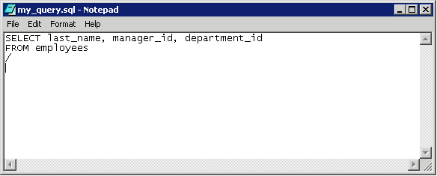
Using the SAVE, START, and EDIT Commands
EDIT my_query
Notes:
Oracle Database 11g: SQL Fundamentals I D - <number>
Using the SAVE, START, and EDIT Commands (continued)
EDIT
Use the EDIT command to edit an existing script. This opens an editor with the script file in it. When you have made the changes, quit the editor to return to the SQL*Plus command line.
Note: The “/” is a delimiter that signifies the end of the statement. When encountered in a file, SQL*Plus runs the statement prior to this delimiter. The delimiter must be the first character of a new line immediately following the statement.

Slide 22
Using the SQL*Plus SPOOL Command
SPO[OL] [file_name[.lst] [CRE[ATE] | REP[LACE] | APP[END]] | OFF | OUT]
Option | Description
file_name[.lst] | Spools output to the specified file name
CRE[ATE] | Creates a new file with the name specified
REP[LACE] | Replaces the contents of an existing file. If the file does not exist, REPLACE creates the file.
APP[END] | Adds the contents of the buffer to the end of the file you specify
OFF | Stops spooling
Notes:
Oracle Database 11g: SQL Fundamentals I D - <number>
Using the SQL*Plus SPOOL Command
The SPOOL command stores query results in a file or optionally sends the file to a printer. The SPOOL command has been enhanced. You can now append to, or replace an existing file, where previously you could only use SPOOL to create (and replace) a file. REPLACE is the default.
To spool output generated by commands in a script without displaying the output on the screen, use SET TERMOUT OFF. SET TERMOUT OFF does not affect output from commands that run interactively.
You must use quotes around file names containing white space. To create a valid HTML file using SPOOL APPEND commands, you must use PROMPT or a similar command to create the HTML page header and footer. The SPOOL APPEND command does not parse HTML tags. SET SQLPLUSCOMPAT[IBILITY] to 9.2 or earlier to disable the CREATE, APPEND and SAVE parameters.

Slide 23
The COLUMN Command
Controls display of a column :
COL[UMN] {column[alias]} [option]
Create column headings
COLUMN ename HEADING ‘Employee’
COLUMN ename HEADING ‘Employee|Name’
Display the current setting for the name
COLUMN ename
Clear settings for the ename column
COLUMN ename CLEAR

Slide 24
Different Options
CLE[AR]
FOLD_A[FTER]
FOLD_B[EFORE]
FOR[MAT] format
HEA[DING] text
JUS[TIFY] {L[EFT]|C[ENTER]|C[ENTRE]|R[IGHT]}

Slide 25
NEWL[INE]
NEW_V[ALUE] variable
NOPRI[NT]|PRI[NT]
NUL[L] text
OLD_V[ALUE] variable
WRA[PPED] WOR[D_WRAPPED] | TRU[NCATED]

Slide 26
DISCONNECT
DISC[ONNECT]
Commits pending changes to the database and logs the current username out of Oracle, but does not exit SQL*Plus.

Slide 27
EXECUTE
EXEC[UTE] statement
Executes a single PL/SQL statement. The EXECUTE command is often useful when you want to execute a PL/SQL statement that references a stored procedure.

Slide 28
HELP
HELP [topic]
Accesses the SQL*Plus help system.
Enter HELP INDEX for a list of topics.

Slide 29
PROMPT
PRO[MPT] [text]
Sends the specified message or a blank line to the user's screen.
PROMPT Please enter a valid department
ACCEPT NEWDEPT NUMBER PROMPT 'Department ID?> '

Slide 30
RUN
Syntax
R[UN]
Lists and executes the SQL command or PL/SQL block currently stored in the SQL buffer.

Slide 31
SHUTDOWN
SHUTDOWN
[ABORT | IMMEDIATE | NORMAL | TRANSACTIONAL]
Notes:
Shuts down a currently running Oracle instance, optionally closing and dismounting a database. You cannot use SHUTDOWN to stop Oracle instances on Oracle7 servers.

Slide 32
Syntax Element | Description
ABORT | All current client SQL statements are immediately terminated. Uncommitted transactions are not rolled back until next startup. All connected users are disconnected.

Slide 33
Syntax Element | Description
IMMEDIATE | Current client SQL statements being processed by the database are allowed to complete. Uncommitted transactions are rolled back. All connected users are disconnected.

Slide 34
Syntax Element | Description
NORMAL | No new connections are allowed after the statement is issued. Before shutting down, the database waits for currently connected users to disconnect

Slide 35
Syntax Element | Description
TRANSACTIONAL | Clients currently conducting transactions are allowed to complete, that is, either commit or terminate before shutdown. No client can start a new transaction on this instance; any client attempting to start a new transaction is disconnected. After all transactions have either committed or terminated, any client still connected is disconnected.

Slide 36
STARTUP
STARTUP [FORCE] [RESTRICT] [PFILE=filename] [MOUNT [dbname]
| OPEN [open_options] [dbname] | NOMOUNT]
where open_options has the following syntax:
READ {ONLY | WRITE [RECOVER]} | RECOVER
Notes:
Starts an Oracle instance with several options, including mounting and opening a database. You cannot use STARTUP to start Oracle7 instances.

Slide 37
-Show Command
SHO[W] option

Slide 38
-Show Command
ALL : Lists the settings of all SHOW options, except ERRORS and SGA, in alphabetical order.
BTI[TLE] : Shows the current BTITLE definition.
SPOO[L] : Shows whether output is being spooled.
SQLCODE : Shows the value of SQL.SQLCODE (the SQL return code of the most recent operation).
TTI[TLE] : Shows the current TTITLE definition.
USER : Shows the username you are currently using to access SQL*Plus.

Slide 39
-Show Command
PNO : Shows the current page number.
REL[EASE] : Shows the release number of Oracle that SQL*Plus is accessing.
REPF[OOTER] : Shows the current REPFOOTER definition.
REPH[EADER] : Shows the current REPHEADER definition.

Slide 40
-SET Command
SET Command
SET system_variable value
Sets a system variable to alter the SQL*Plus environment settings for your current session, for example:
    The display width for NUMBER data
    Turning on HTML formatting
    Enabling or disabling the printing of column headings
    The number of lines per page

Slide 41
-SET Command
SQL*Plus maintains system variables (also called SET Command variables) to enable you to setup a particular environment for a SQL*Plus session.
You can change these system variables with the SET command and list them with the SHOW command.
SET ROLE and SET TRANSACTION are SQL commands
When not followed by the keywords ROLE or TRANSACTION , SET is assumed to be a SQL*Plus command.

Slide 42
-SET Command
ARRAY[SIZE] {15|n}
Sets the number of rows, called a batch, that SQL*Plus will fetch from the database at one time.
Valid values are 1 to 5000.
ARRAYSIZE has no effect on the results of SQL*Plus operations other than increasing efficiency.

Slide 43
-SET Command
AUTO[COMMIT]{ON|OFF|IMM[EDIATE]|n}
Controls when Oracle commits pending changes to the database.
ON/IMMEDIATE commits pending changes to the database after Oracle executes each successful INSERT, UPDATE, or DELETE command or PL/SQL block.
OFF suppresses automatic committing so that you must commit changes manually (for example, with the SQL command COMMIT).
n commits pending changes to the database after Oracle executes n successful SQL INSERT, UPDATE, or DELETE commands or PL/SQL blocks.
(Where 0<=n<=2000,000,000)

Slide 44
-SET Command
AUTOP[RINT] {ON|OFF}
,,
Sets the automatic PRINTing of bind variables
ON or OFF controls whether SQL*Plus automatically displays bind variables (referenced in a successful PL/SQL block or used in an EXECUTE command)
BLO[CKTERMINATOR] {.|c} |
Sets the non-alphanumeric character used to end PL/SQL blocks to c.
It cannot be an alphanumeric character or a whitespace.
To execute the block, you must issue a RUN or / (slash) command.

Slide 45
-SET Command
AUTORECOVERY [ON|OFF]
ON sets the RECOVER command to automatically apply the default filenames of archived redo log files needed during recovery.
No interaction is needed when AUTORECOVERY is set to ON, provided the necessary files are in the expected locations with the expected names.
SET AUTORECOVERY ON
RECOVER DATABASE (DBA Previlage)

Slide 46
-SET Command
AUTOT[RACE] {ON|OFF|TRACE[ONLY]} [EXP[LAIN]] [STAT[ISTICS]]
Displays a report on the execution of successful SQL DML statements (SELECT, INSERT, UPDATE or DELETE).
The report can include execution statistics and the query execution path.

Slide 47
-SET Command
CMDS[EP] {;|c|ON|OFF}
Sets the non-alphanumeric character used to separate multiple SQL*Plus commands entered on one line to c.
ON or OFF controls whether you can enter multiple commands on a line.
ON automatically sets the command separator character to a semicolon (;).
  set cmdsep on
  set cmdsep +
  TTITLE LEFT 'SALARIES' + COLUMN sal FORMAT $99,999 + select * from emp;

Slide 48
-SET Command
COM[PATIBILITY]{V7|V8|NATIVE} |
Specifies the version of Oracle to which you are currently connected.
Set COMPATIBILITY to V7 for Oracle7, or to V8 for Oracle8 or later. Set COMPATIBILITY to NATIVE if you wish the database to determine the setting (If connected to Oracle11g, compatibility defaults to NATIVE).

Slide 49
-SET Command
Application of COMPATIBILITY
To run a command file, SALARY.SQL, created with Oracle7 SQL syntax, enter
SET COMPATIBILITY V7
START SALARY
After running the file, reset compatibility to NATIVE to run command files created for Oracle11g:
SET COMPATIBILITY NATIVE

Slide 50
-SET Command
COPYC[OMMIT] {0|n} (0<=n<=5000)
Controls the number of batches after which the COPY command commits changes to the database.
COPY commits rows to the destination database each time it copies n row batches.
DEF[INE] {&|c|ON|OFF}
Sets the character used to prefix substitution variables t c.
ON or OFF controls whether SQL*Plus will scan commands for substitution variables and replace them with their values.
ON changes the value of c back to the default '&', not the most recently used character.

Slide 51
-SET Command
ECHO {ON|OFF}
Controls whether the START command lists each command in a command file as the command is executed.
    ON lists the commands
    OFF suppresses the listing. Default
SET ECHO ON : Start the script with displaying commands
EMB[EDDED] {ON|OFF}
Controls where on a page each report begins.
OFF forces each report to start at the top of a new page.
ON allows a report to begin anywhere on a page.

Slide 52
-SET Command
ESC[APE] {\|c|ON|OFF}
Defines the character you enter as the escape character (c).
OFF undefines the escape character.
ON enables the escape character. ON changes the value of c back to the default "\".
Notes:
You can use the escape character before the substitution character (set through SET DEFINE) to indicate that SQL*Plus should treat the substitution character as an ordinary character rather than as a request for variable substitution.

Slide 53
-SET Command
If you define the escape character as an exclamation point (!), then
SET ESCAPE !
ACCEPT v1 PROMPT 'Enter !&1:'
displays this prompt:
Enter &1:
To set the escape character back to the default value of \ (backslash), enter
SET ESCAPE ON

Slide 54
-SET Command
FEED[BACK] {6|n|ON|OFF}
Displays the number of records returned by a query when a query selects at least n records.
ON or OFF turns this display on or off.
Turning feedback ON sets n to 1. Setting feedback to zero is equivalent to turning it OFF.
HEA[DING] {ON|OFF}
Controls printing of column headings in reports.
ON prints column headings in reports
OFF suppresses column headings.
The SET HEADING OFF command will not affect the column width displayed, and only suppresses the printing of the column header itself.

Slide 55
-SET Command
To suppress the display of column headings in a report, enter
SET HEADING OFF
If you then run a SQL SELECT command
SELECT LAST_NAME, SALARY
FROM EMP_DETAILS_VIEW
WHERE JOB_ID = 'AC_MGR';
the following output results:
Higgins 12000
To turn the display of column headings back on, enter
SET HEADING ON

Slide 56
-SET Command
LIN[ESIZE] {80|n}
Sets the total number of characters that SQL*Plus displays on one line before beginning a new line
PAGES[IZE] {14|n}
Sets the number of lines in each page.

